Slide 1
IoT Gateway

Slide 2
IoT Architecture Key Components

Slide 3
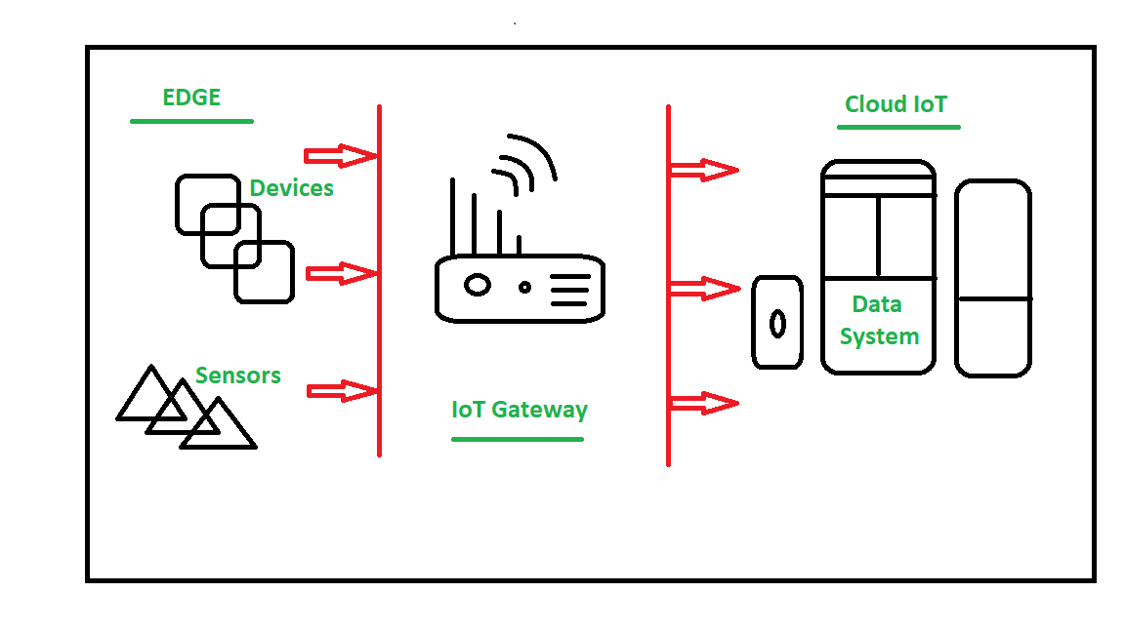
IoT gateways
Every IoT system needs some way to connect sensors/devices to the cloud so that data can be sent back-and-forth between them.
IoT gateways can be essential in making this connection possible because gateways act as bridges between sensors/devices and the cloud.
Many sensors/devices will “talk” to a gateway and the gateway will then take all that information and “talk” to the cloud.

Slide 4
IoT gateways benefits
Battery life :Gateways allow sensors/devices to communicate over shorter distances, boosting battery life.
Varying protocols :Gateways can communicate with sensors/devices over varying connectivity types and then translate that data into a standard protocol such as MQTT to be sent to the cloud.
Unfiltered data: Gateways can pre-process and filter the data being generated by sensors/devices to decrease transmission, processing, and storage requirements.
High latency: Gateways can reduce latency in time-critical applications by performing processing on the gateway itself rather than in the cloud.
Security: Gateways reduce the number of sensors/devices connected to the internet because the sensors/devices are only connected to the gateway. However, this makes gateways themselves targets and also the first line of defense. This is why security needs to be a priority for any gateway.

Slide 5
Examples
OAS Platform :
https://openautomationsoftware.com/open-automation-systems-blog/what-is-an-iot-gateway/
Cisco IoT Gateway
https://www.cisco.com/c/en/us/products/routers/iot-gateways/index.html
LoRaWAN Gateway
https://www.lairdconnect.com/wireless-modules/lorawan-solutions
Intel IoT Gateway.
https://www.intel.com/content/dam/www/public/us/en/documents/product-briefs/gateway-solutions-iot-brief.pdf

Slide 6
Azure IoT Gateway
The Azure IoT protocol gateway is a framework for protocol adaptation that is designed for high-scale, bidirectional device communication with IoT Hub.
The protocol gateway is a pass-through component that accepts device connections over a specific protocol.
The Azure IoT protocol gateway includes an MQTT protocol adapter that enables you to customize the MQTT protocol behavior if necessary.
The Azure IoT protocol gateway programming model allows you to plug in custom components for specialized processing such as custom authentication, message transformations, compression/decompression, or encryption/decryption of traffic between the devices and IoT Hub.

Slide 7
AWS IoT gateway
Module : Device Gateway
The Device Gateway serves as the entry point for IoT devices connecting to AWS.
The Device Gateway manages all active device connections and implements semantics for multiple protocols to ensure that devices are able to securely and efficiently communicate with AWS IoT Core.
Currently the Device Gateway supports the MQTT, WebSockets, and HTTP 1.1 protocols.
For devices that connect using MQTT or WebSockets the Device Gateway will maintain long lived, bidirectional connections, enabling these devices to send and receive messages at any time with low latency.
The Device Gateway is fully managed and scales automatically to support over a billion devices without requiring you to manage any infrastructure.
For customers migrating to AWS IoT, the Device Gateway offers capabilities to transition infrastructures with minimal impact to existing architectures and IoT devices

Slide 8
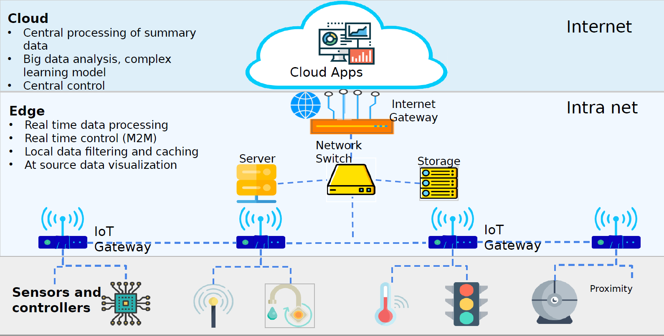
Edge Computing

Slide 9
Edge Computing Characteristics
Geographically distributed
Scalable
Autonomous and distributed
Edge computing is contextual and low latency
Real-time interactions
Heterogeneous

Slide 10
Benefits of Edge Computing
Faster Response
Operating at the source of data
Faster response time for triggers
Secure
Locally stored
No theft during transport
Compliance maintained
Reliable Operations
Can work without connectivity.
Cost Effective
No need to transport everything to cloud
No recurring cost

Slide 11
Applications of Edge Computing
Applications That Require Autonomy
Self-driving cars
Applications That Can’t Tolerate Latency
Health Care services
Applications that need significant bandwidth
Video streaming

Slide 12
Artificial Intelligence on the edge
Azure also offers services such as Azure Functions, Azure Stream Analytics and Azure Machine Learning which can all be run via Azure IoT Edge.
This means that you can deploy AI, including image recognition, machine learning and complex event processing without having to write the code in-house.
Azure IoT Edge's components:
IoT Edge modules
The IoT Edge runtime
A cloud-based interface.

Slide 13
IoT Edge modules
These are containers that run Azure services, 3rd party services, or your own code.
IoT Edge modules are deployed and execute locally on IoT Edge devices. Multiple modules can be configured to communicate with each other.
You can also package Azure services into modules or develop custom modules. If you want to deploy your own code to your devices, Azure IoT Edge supports both Linux and Windows and Java, .NET Core 2.0, Node.js, C, and Python.

Slide 14
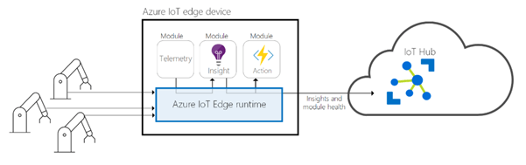
The IoT Edge runtime
This runs on each IoT Edge device and manages the modules deployed there.
It performs a number of functions including monitoring and managing the device and facilitating communications between the modules, the device, other devices, and the cloud.
The runtime supports both Linux and Windows operating systems.

Slide 15
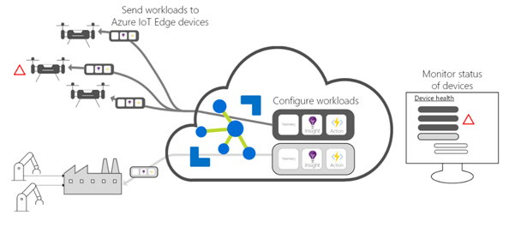
Cloud-based interface
This interface allows you to remotely monitor and manage IoT Edge devices.
Cloud services allow users to create and configure a workload to be run on a specific type of device, send a workload to a set of devices and monitor workloads running on devices in the field.

Slide 16
Using an IoT edge device as a gateway
There are three patterns for using an IoT Edge device as a gateway:
transparent
protocol translation
identity translation

Slide 17
References
https://www.iotforall.com/what-is-a-gateway/
Adrian McEwen and Hakim Cassimally. 2013. Designing the Internet of Things (1st. ed.). Wiley Publishing.
https://www.slideshare.net/chetansk/edge-computing-109820603?qid=4b1c2bc7-46b5-4d29-b2fe-5b431903277e&v=&b=&from_search=1
https://www.codeproject.com/Articles/1261285/What-is-IoT-Edge

